Slide 1

Ukhona Pay
By Team UMP

Slide 2
Problem Statement
Digital Inclusion – From cash trader to digital business
Vendors sell goods. Taxi drivers move passengers every day. Generates real and consistent income.
No bank statements, no credit history, and no digital footprint.
Unable to access loans to expand their businesses.

Slide 3
Solution
Ukhona Pay turns every fare and every sale into a simple QR-code payment — no cash, no paperwork.
Each transaction is recorded automatically into an immutable digital ledger the moment it happens.
After 90 days of consistent activity, that ledger becomes a Financial Identity Score banks can actually assess.
Taxi associations approve drivers and collect membership dues digitally, keeping the whole rank connected on one platform.

Slide 4
Features
Phone + PIN sign-in, with dedicated dashboards for drivers, vendors, and taxi associations.
QR-code payments — scan, confirm with a PIN, and settle instantly.
Automatic savings: 5% of every fare set aside for savings, 5% for vehicle maintenance.
Bank payouts, CashSend, and a full immutable transaction history for every account.
A 90-day Financial Identity Score with a recommended credit limit, plus per-role analytics dashboards.

Slide 5
Impact
One taxi rank moves roughly R100,000 in cash every single day — none of it currently recorded.
That's close to R2.7 million a year, per rank, completely invisible to any bank.
Example: 2,520 recorded transactions in 90 days, R12,600 in verified income, a Financial Score of 72/100 — eligible for a R15,000–R20,000 loan.
Mbombela alone has 20+ major taxi ranks. The model scales directly to every one of them, and beyond.

Slide 6
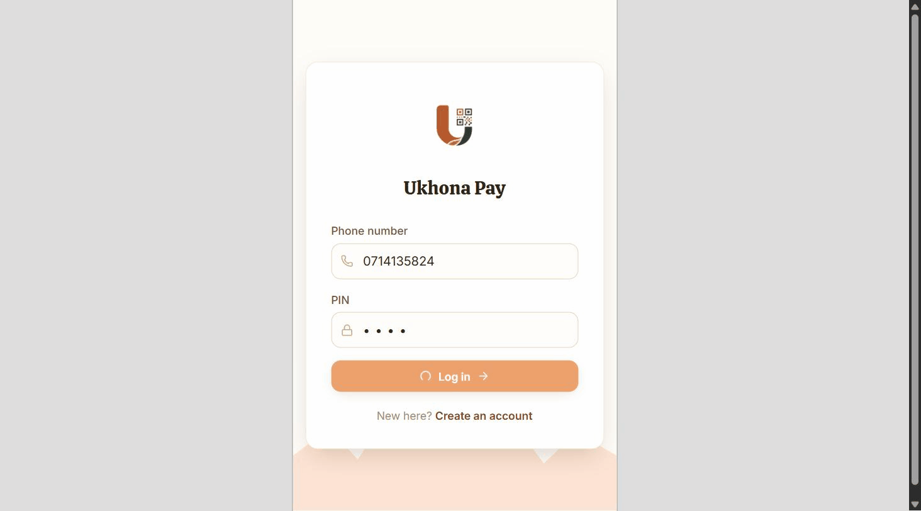
Driver Experience
Every fare Lucky drives is scanned, confirmed, and settled instantly.

Slide 7
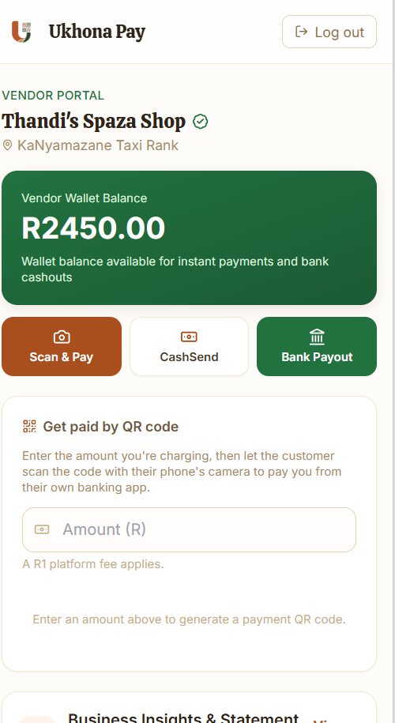
Vendor Experience
One QR code turns any sale at Thandi's stall into a recorded, cashless payment.

Slide 8
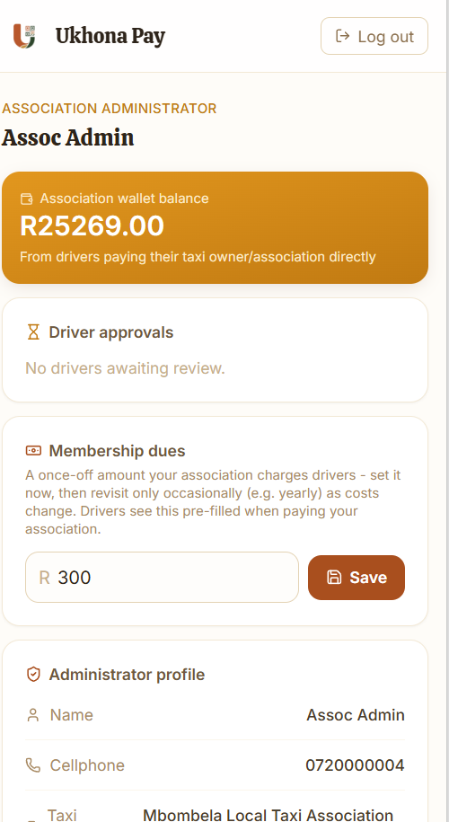
Association Experience
MALTA approves drivers and collects membership dues digitally, in real time.

Slide 9
Technical Architecture
Backend: Spring Boot 3.3 (Java 21), JWT authentication, bcrypt-hashed PINs, pessimistic locking on every wallet transaction.
Frontend: React 19 + Vite + Tailwind CSS, deployed on Vercel.
Database: PostgreSQL 16 on Neon, using a pooled connection since Cloud Run can run several instances at once.
Backend hosted on Google Cloud Run, auto-deployed straight from GitHub on every push via GitHub Actions CI/CD.

Slide 10
Conclusion
Live demo: https://ukhona-pay.vercel.app/
Code (public repo): https://github.com/saxs-14/ukhona-pay
One rank today. 100+ taxi ranks across South Africa tomorrow.

Slide 11
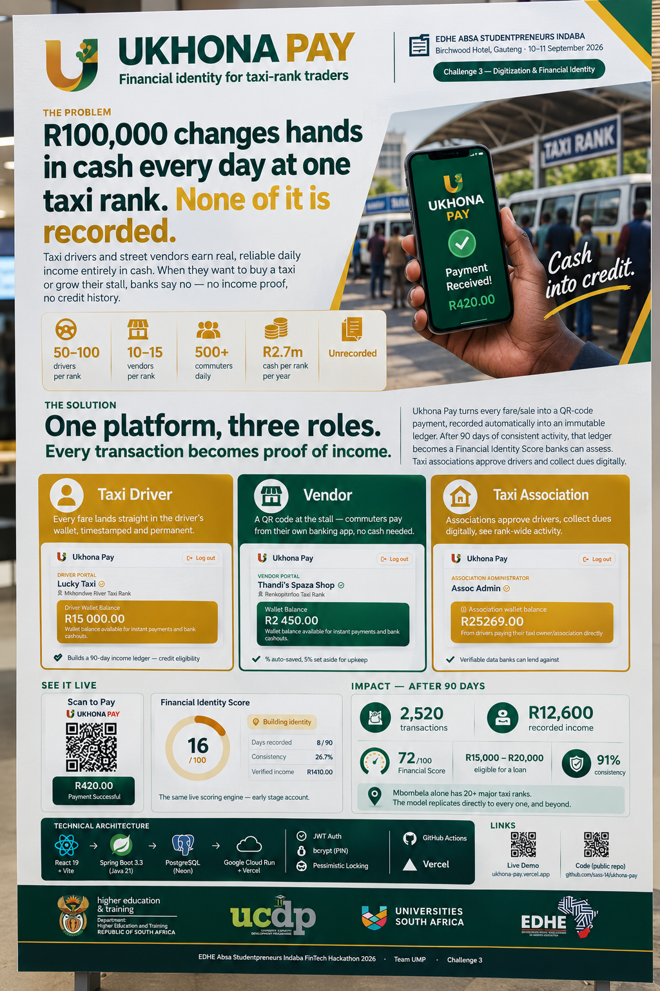
Thank you.
We would be glad to take your questions.

